Slide 1
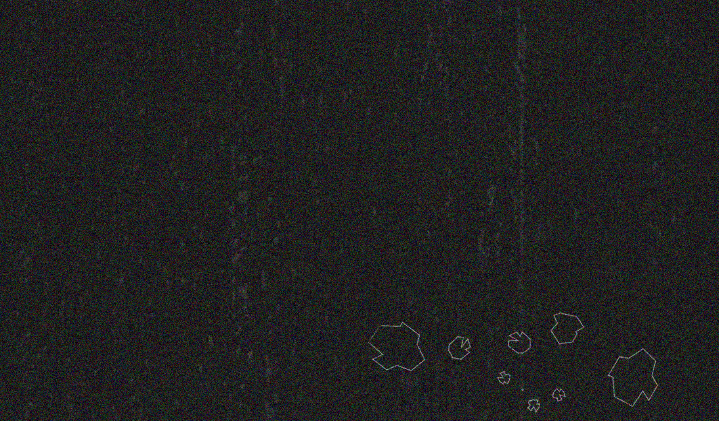
ENGI 301
PCB Board
11 / 22 / 20
Vi Vo

Slide 2
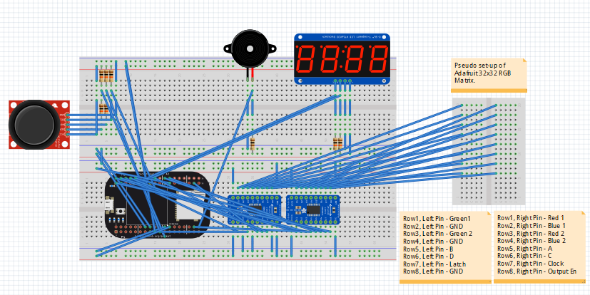
Board Functionality
The PCB is designed for the Clear Asteroids game which is comprised of the following components: A Pocketbeagle board, a piezo buzzer, a joystick module, logic shifters, a hex display, and 32x32 RGB matrix. The current prototype of the game allows users to move the crosshair displayed on the RGB matrix and destroy the asteroids (which activates the Piezo buzzer) by using the joystick module. When the user has successfully destroy the asteroid, the hex display will update with the new score.

Slide 3
Systems Block Diagram
5V 2A Switching Supply
Joystick
Module
GND
+5V
PocketBeagle
+5V
GND
32x32
Adafruit RGB
LED Matrix Panel
GND, P1_22
R1
G1
VR_{x}
VR_{y}
GND, P1_15
GPIO_59 - P2_2
GPIO_58 - P2_4
GPIO_57 - P2_6
GPIO_23 - P2_3
GPIO_26 - P1_34
GPIO_20 - P1_20
B1
GND
SW
GPIO 111
R2
G2
3.3V, P1_14
B2
GND
3.3V, P1_14
A
B
HT16K33 LED Controller
+
GPIO44 - P2_24
GPIO45 - P2_33
GPIO46 - P2_22
GPIO47 - P2_18
GPIO52 - P2_10
C
D
SDA, P2_11
-
CLK
LAT
D
SCL, P2_9
OE
GND
C
AIN 1.8V, 0,7
P1_19, P1_21
GPIO50 - P2_8
PWM0, P1_36
GPIO60 - P2_8
Passive
Buzzer
GND
V_{cc}
Notes:
Joystick - Needs +5V
HT16K33 -

Slide 4
Mechanical Drawing
*Drawing is not to scale
Hex Display
~2” x 1”
Pocket Beagle
~2” x 1.5”
board 5.5” x 3”
.5 spacing Hex-Pocket Beagle
Logic Shifter 1
~.5” x 1”
Logic Shifter 1
~.5” x 1”
Joystick Module
(5 individual slots)
Piezo Buzzer
Notes:
Joystick - Needs +5V
HT16K33 -

